Slide 1
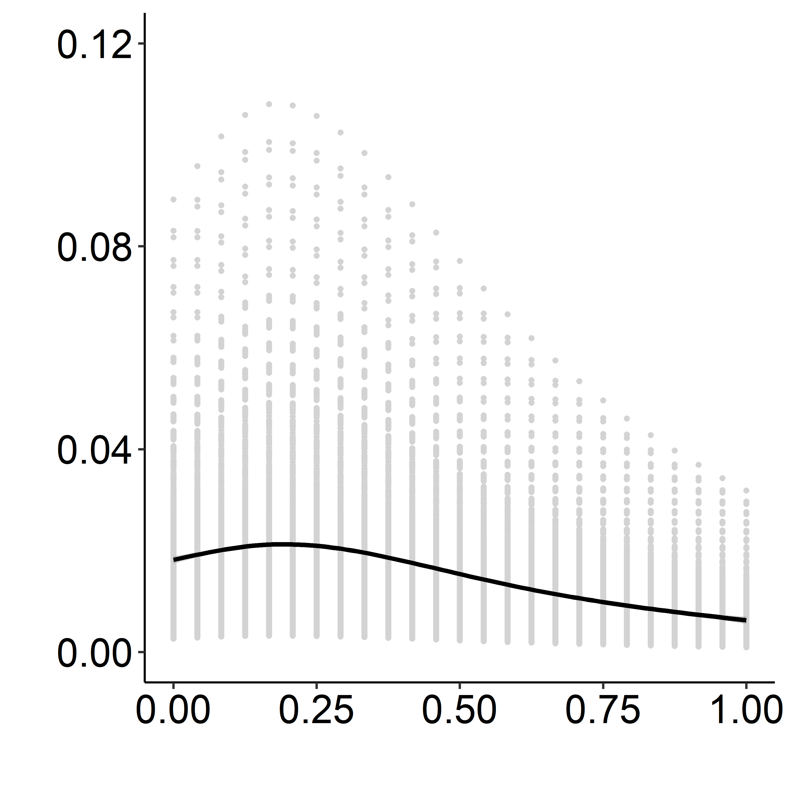
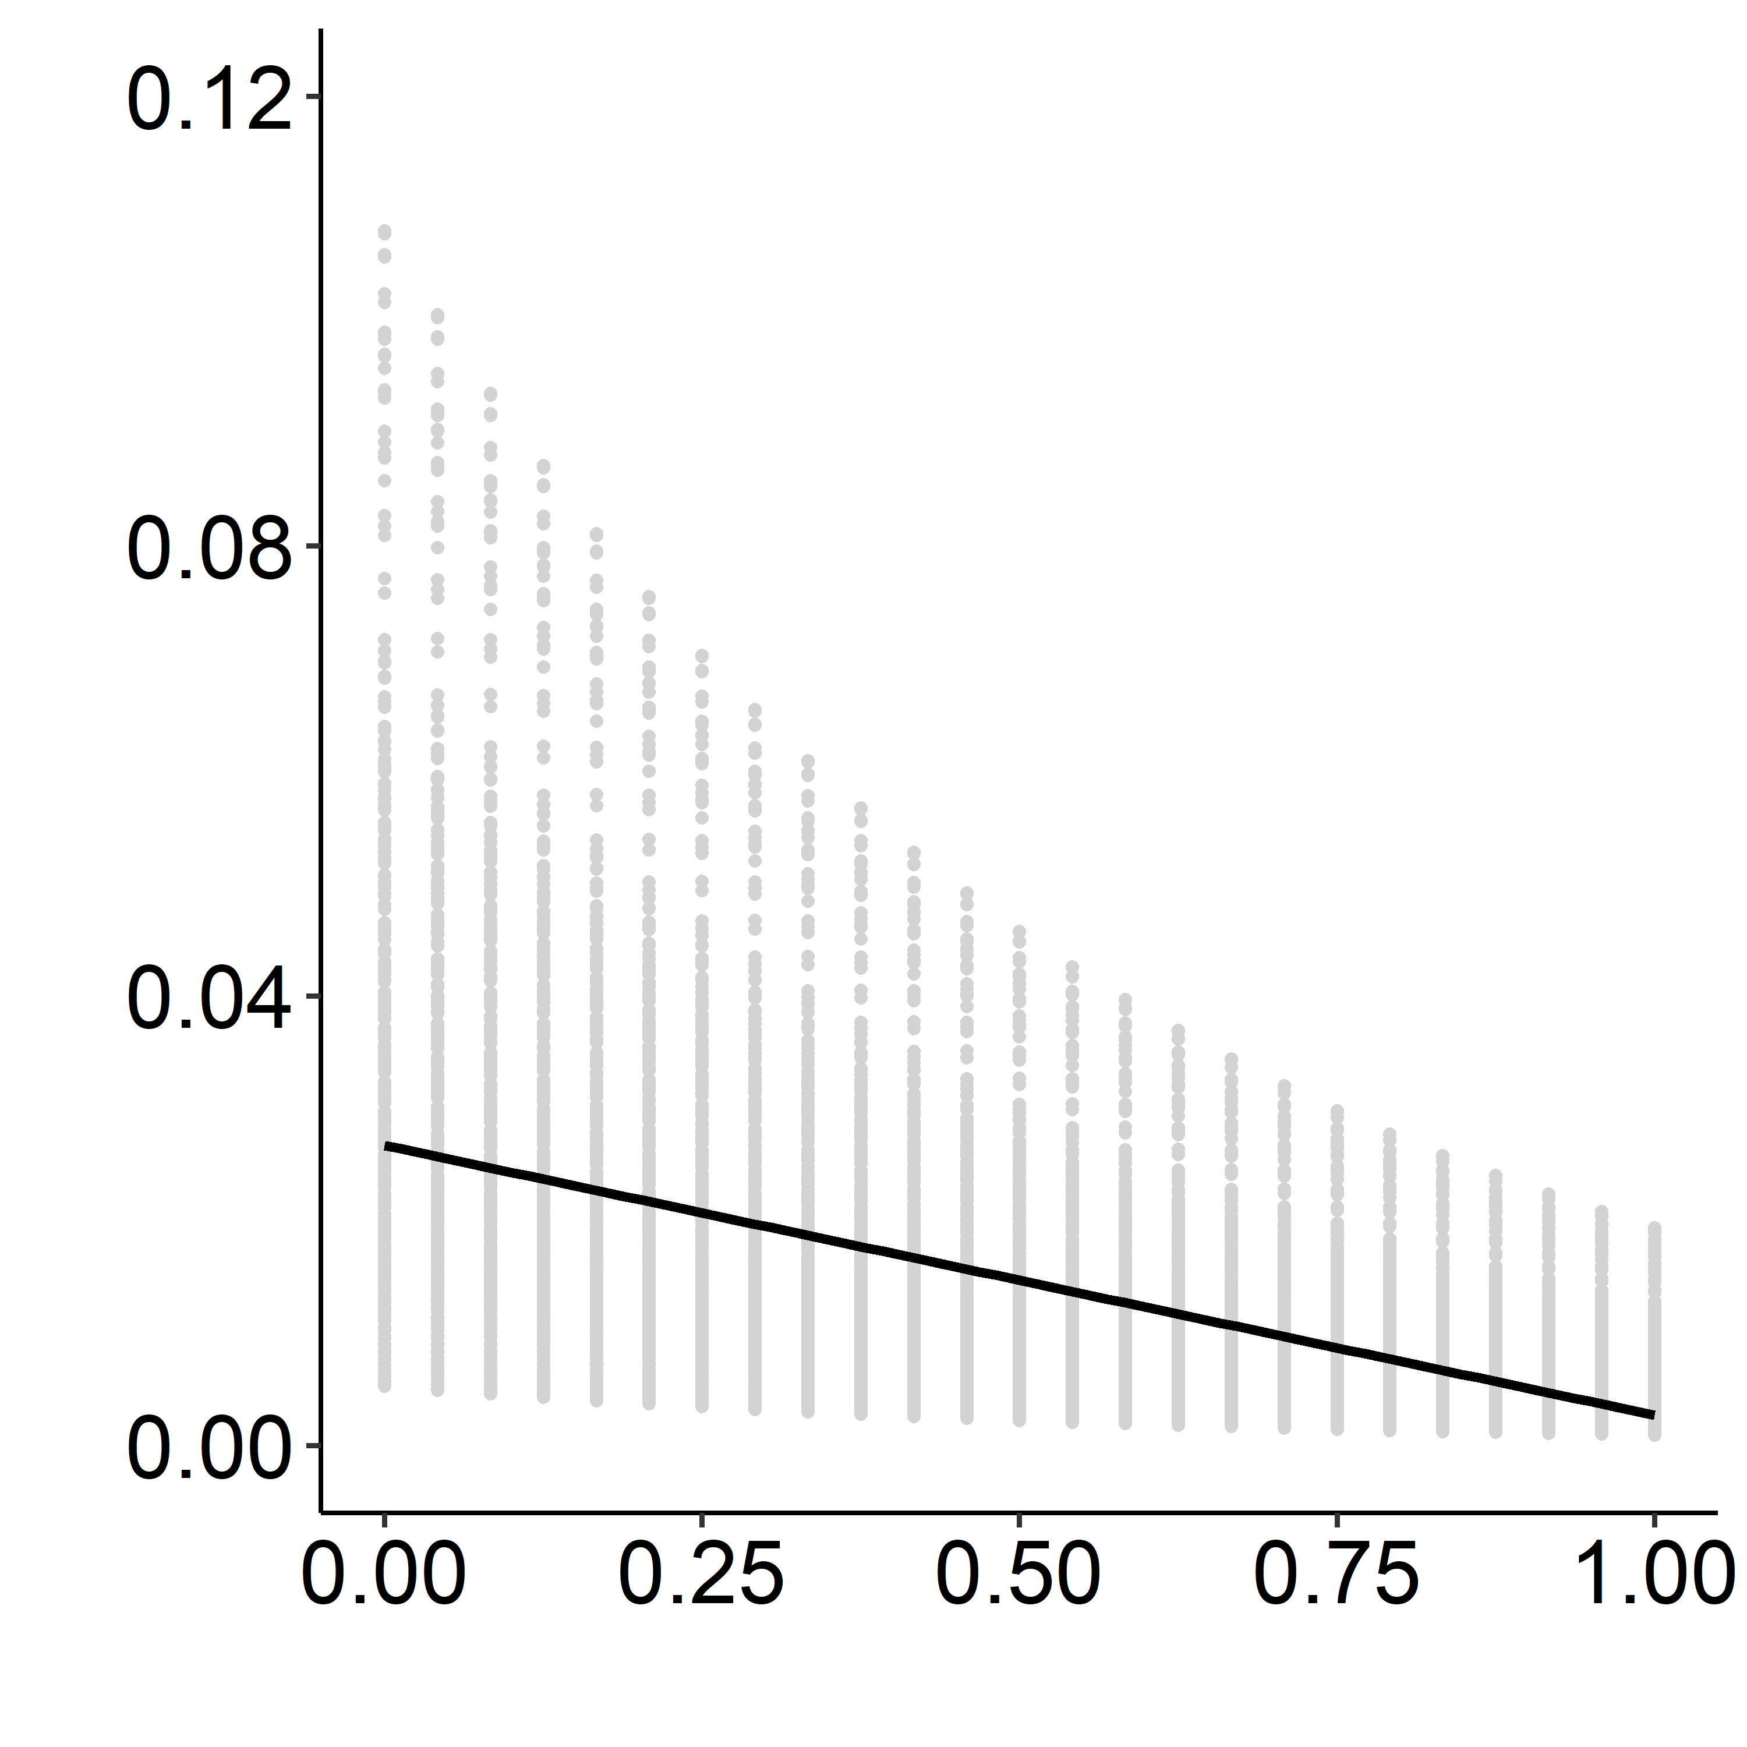
A
B
Predictive locust density (individuals m² ⁻¹)
Predictive locust density (individuals m² ⁻¹)
Bareground proportion
Plant protein proportion

Slide 2
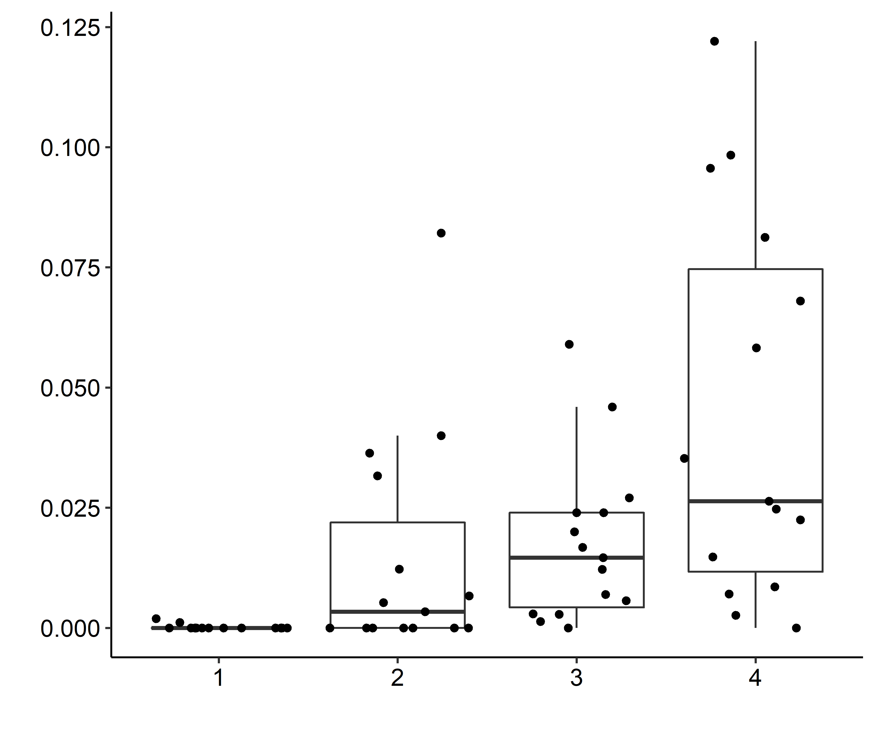
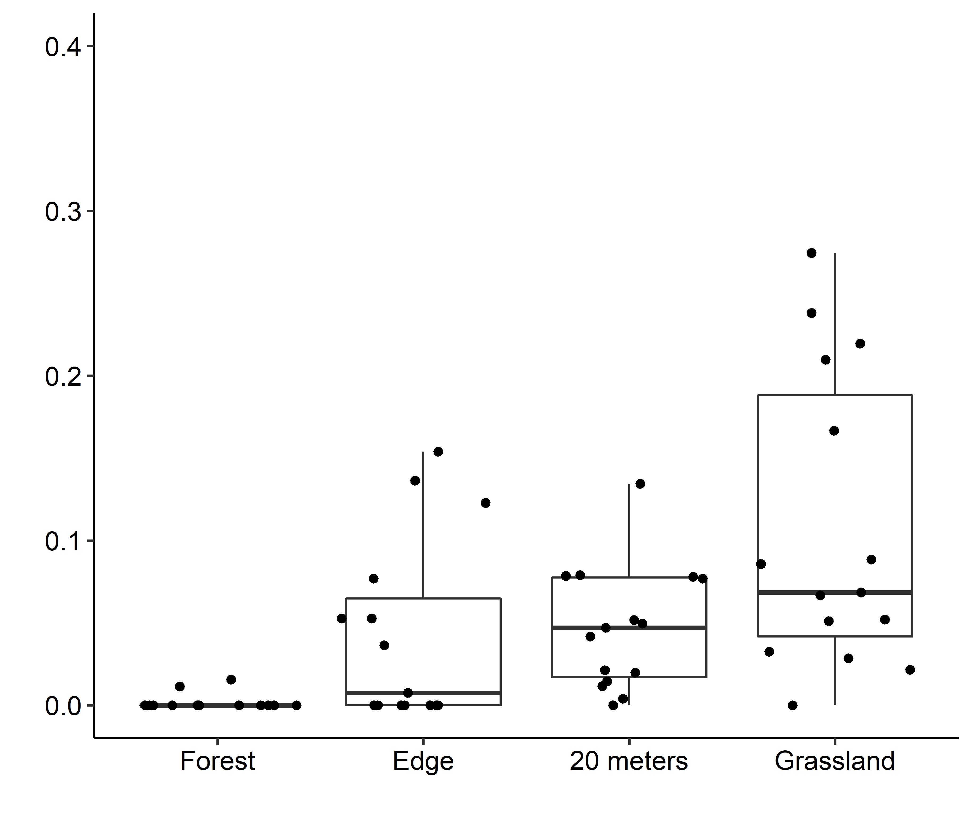
A
c
B
c
a
a,b
b,c
a
b
b
Locust density (individuals m² ⁻¹)
Locust relative abundance
Wooded
area
Edge
20 Meters
Grassy
area
Wooded
area
Edge
20 Meters
Grassy
area

Slide 3
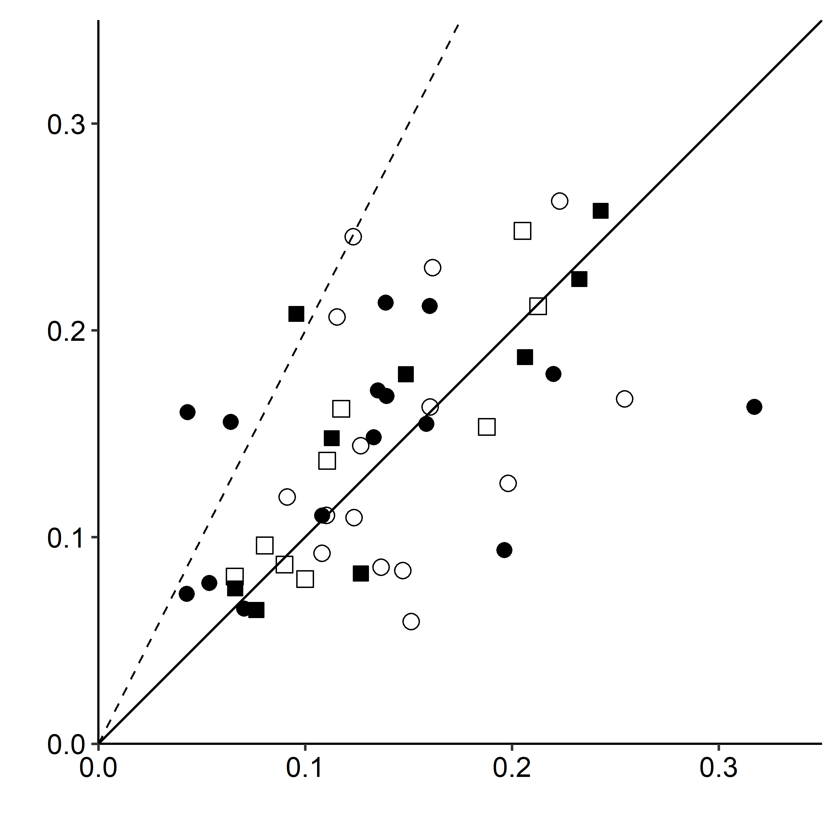
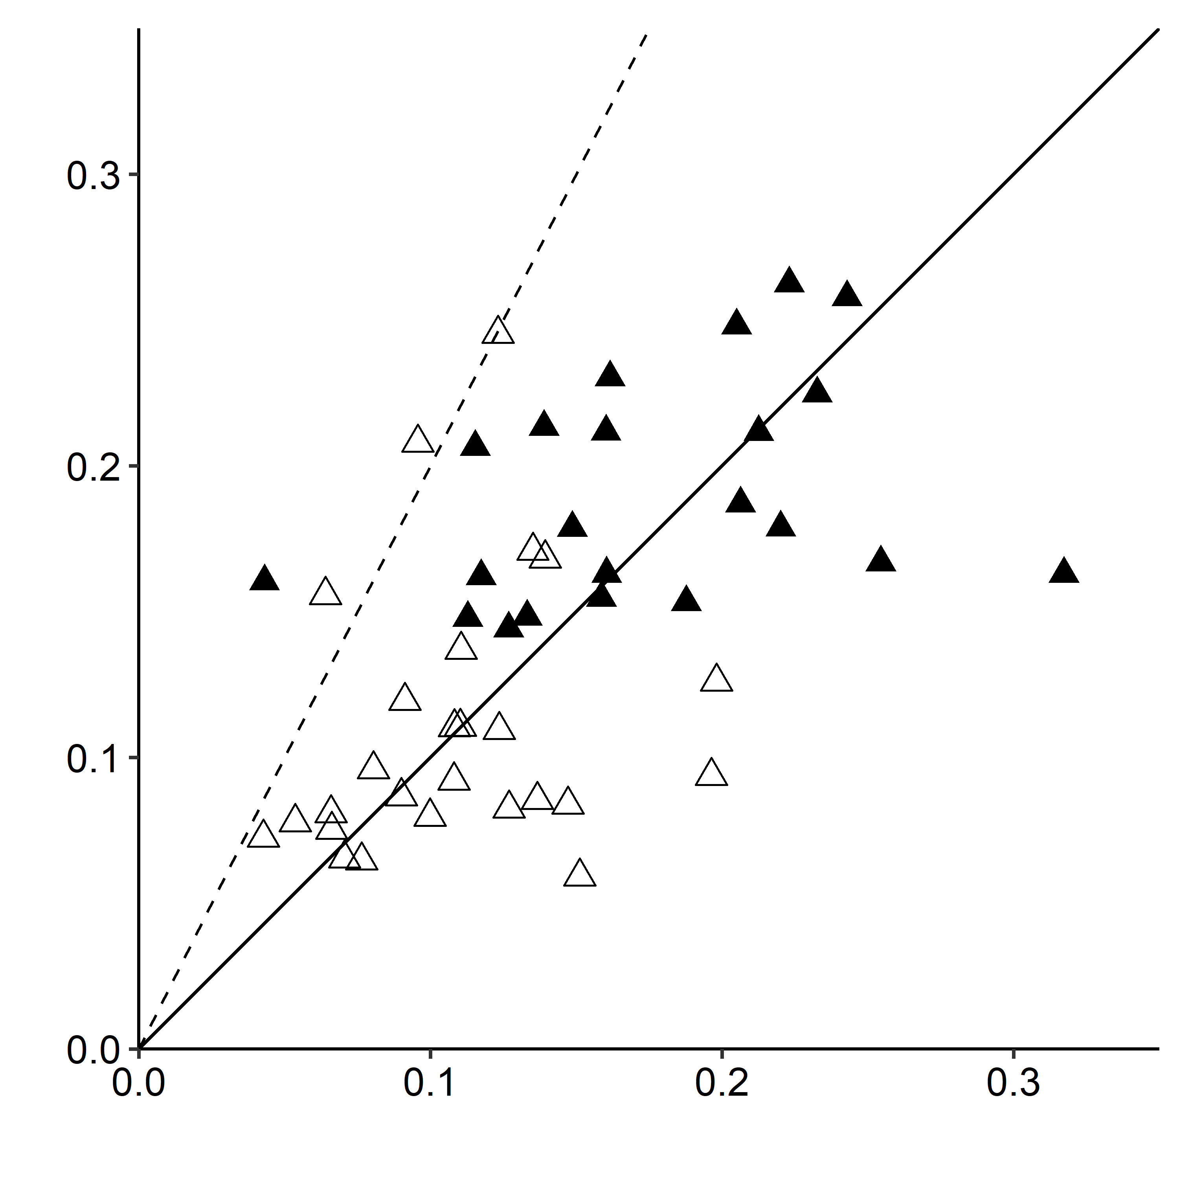
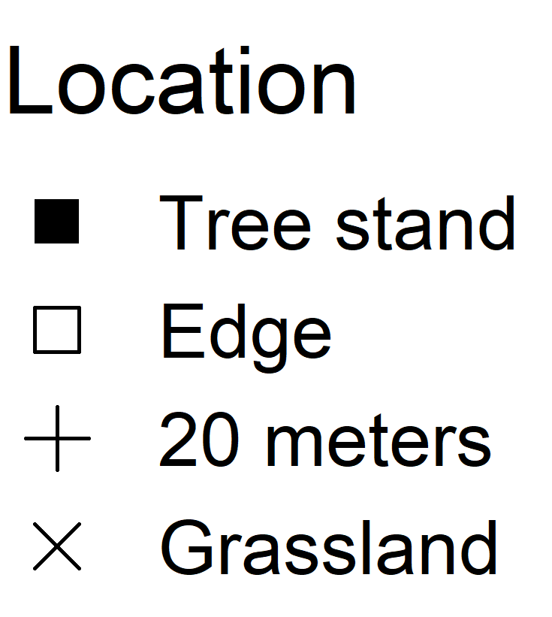
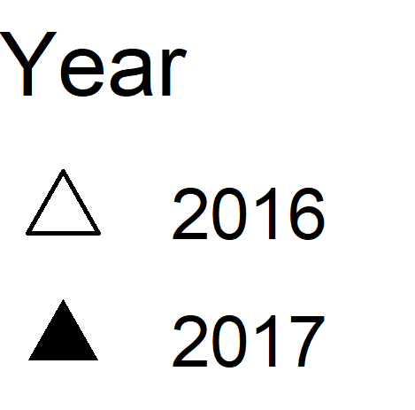
A
B
1 P : 2 C
1 P : 2 C
1 P : 1 C
1 P : 1 C
Plant carbohydrate proportion by dry mass
Plant carbohydrate proportion by dry mass
Plant protein proportion by dry mass
Plant protein proportion by dry mass

Slide 4
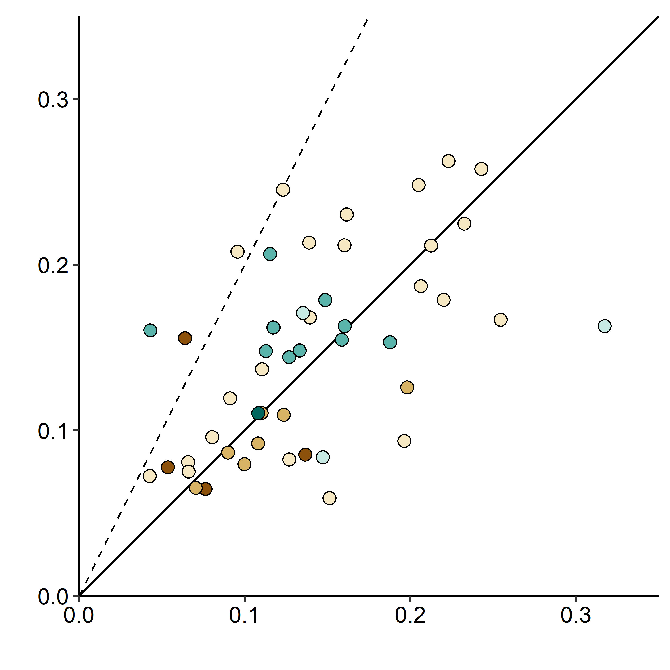
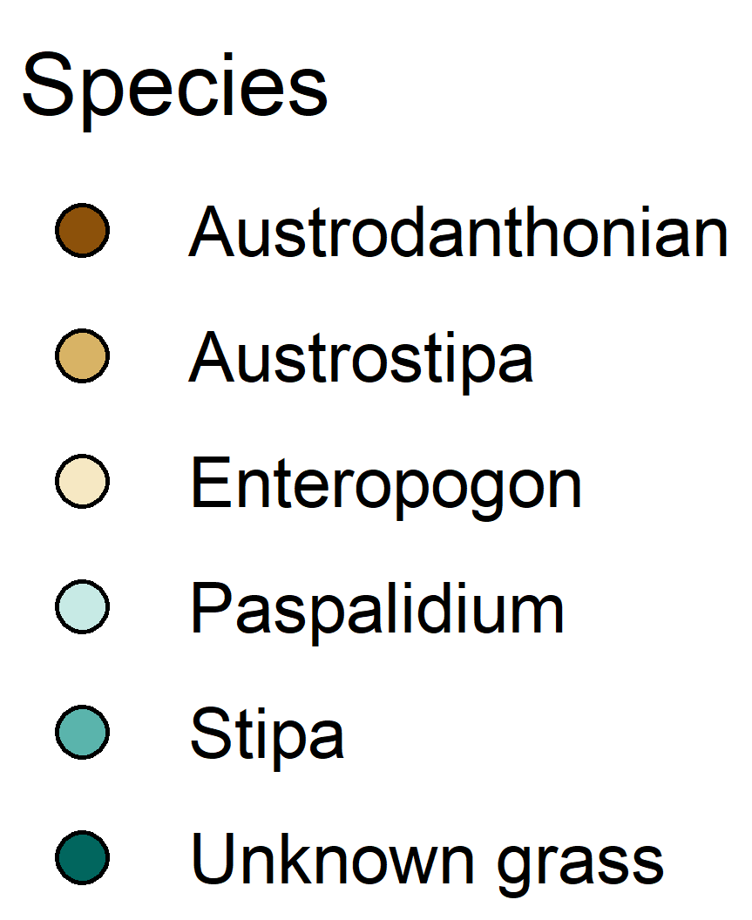
1 P : 2 C
1 P : 1 C
Plant carbohydrate proportion by dry mass
Plant protein proportion by dry mass

Slide 5
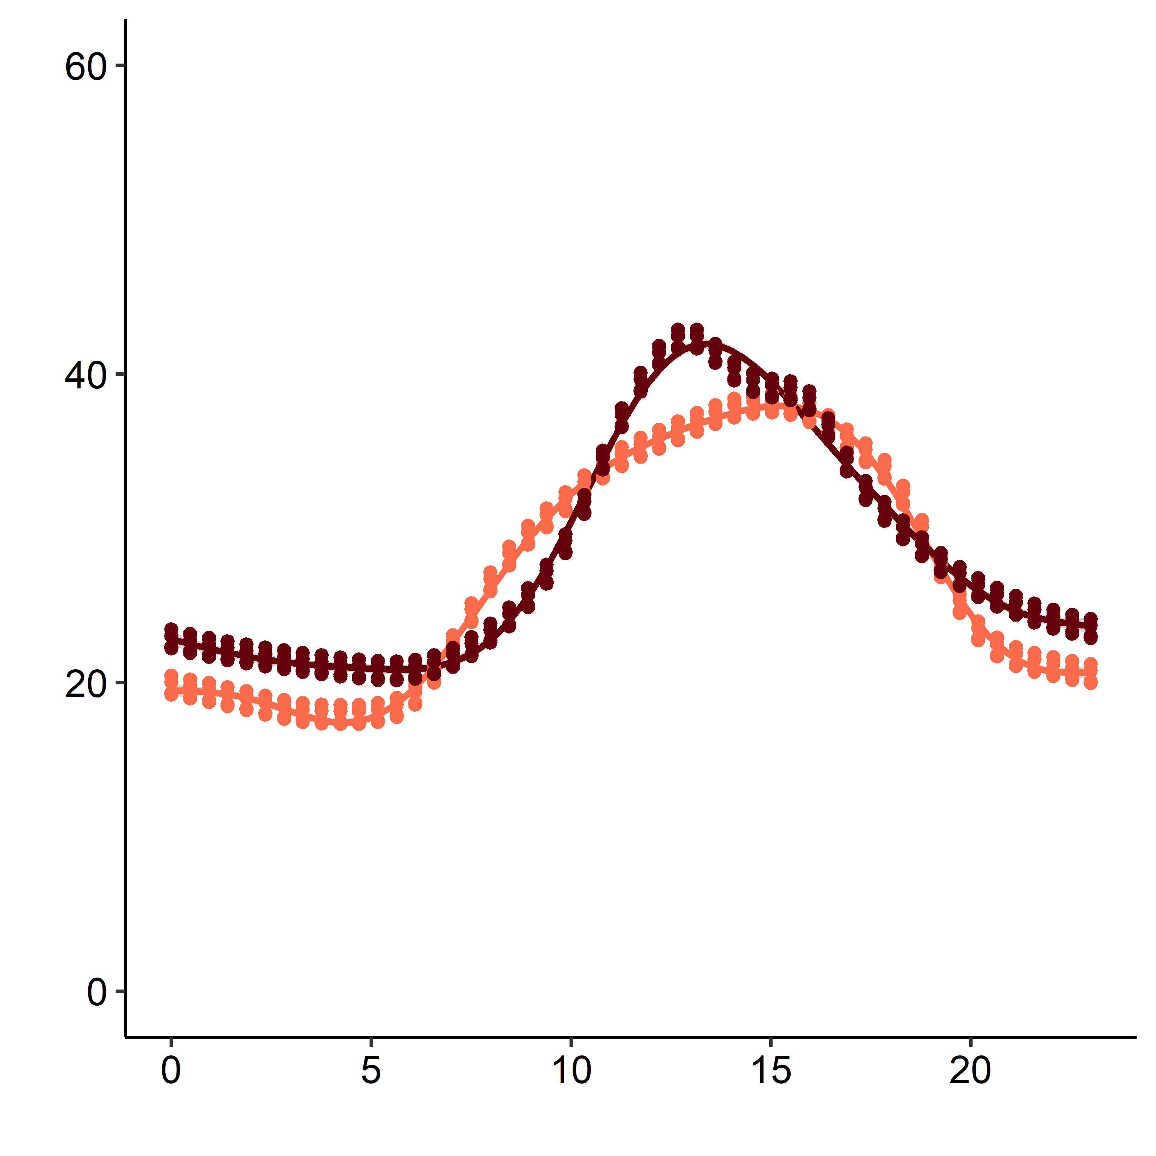
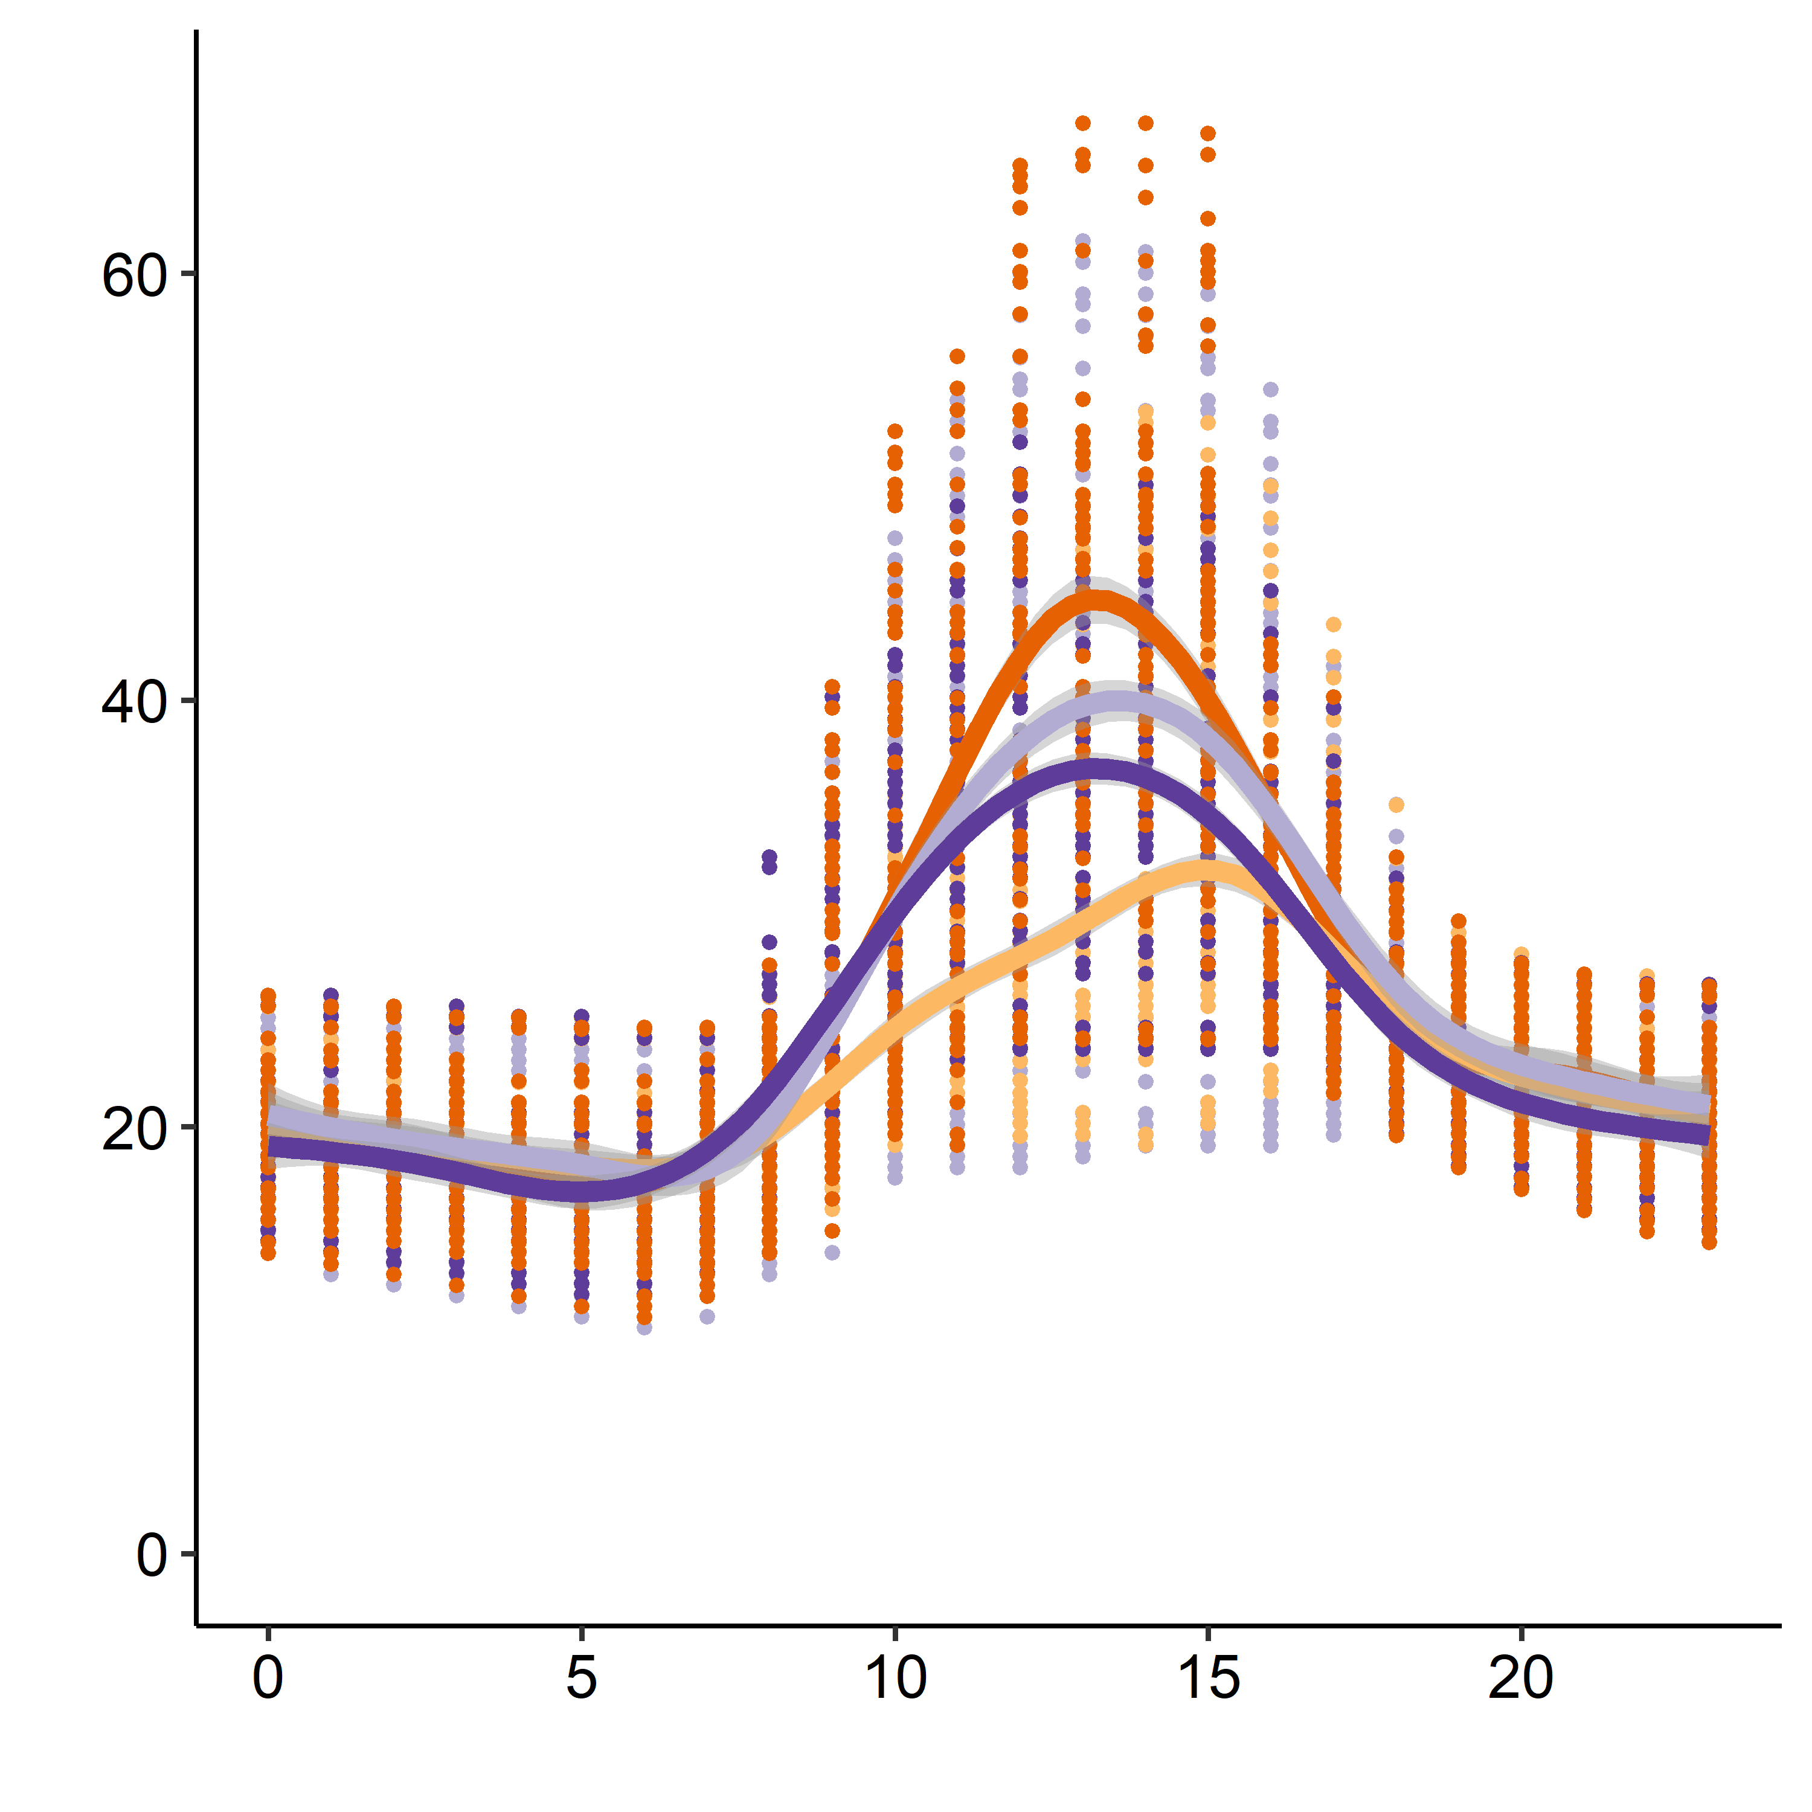
A
Above ground
Ground
B
Wooded area
Edge
20 Meters
Grassy area
Predictive temperature (°C)
Predictive temperature (°C)
Hour
Hour

Slide 6
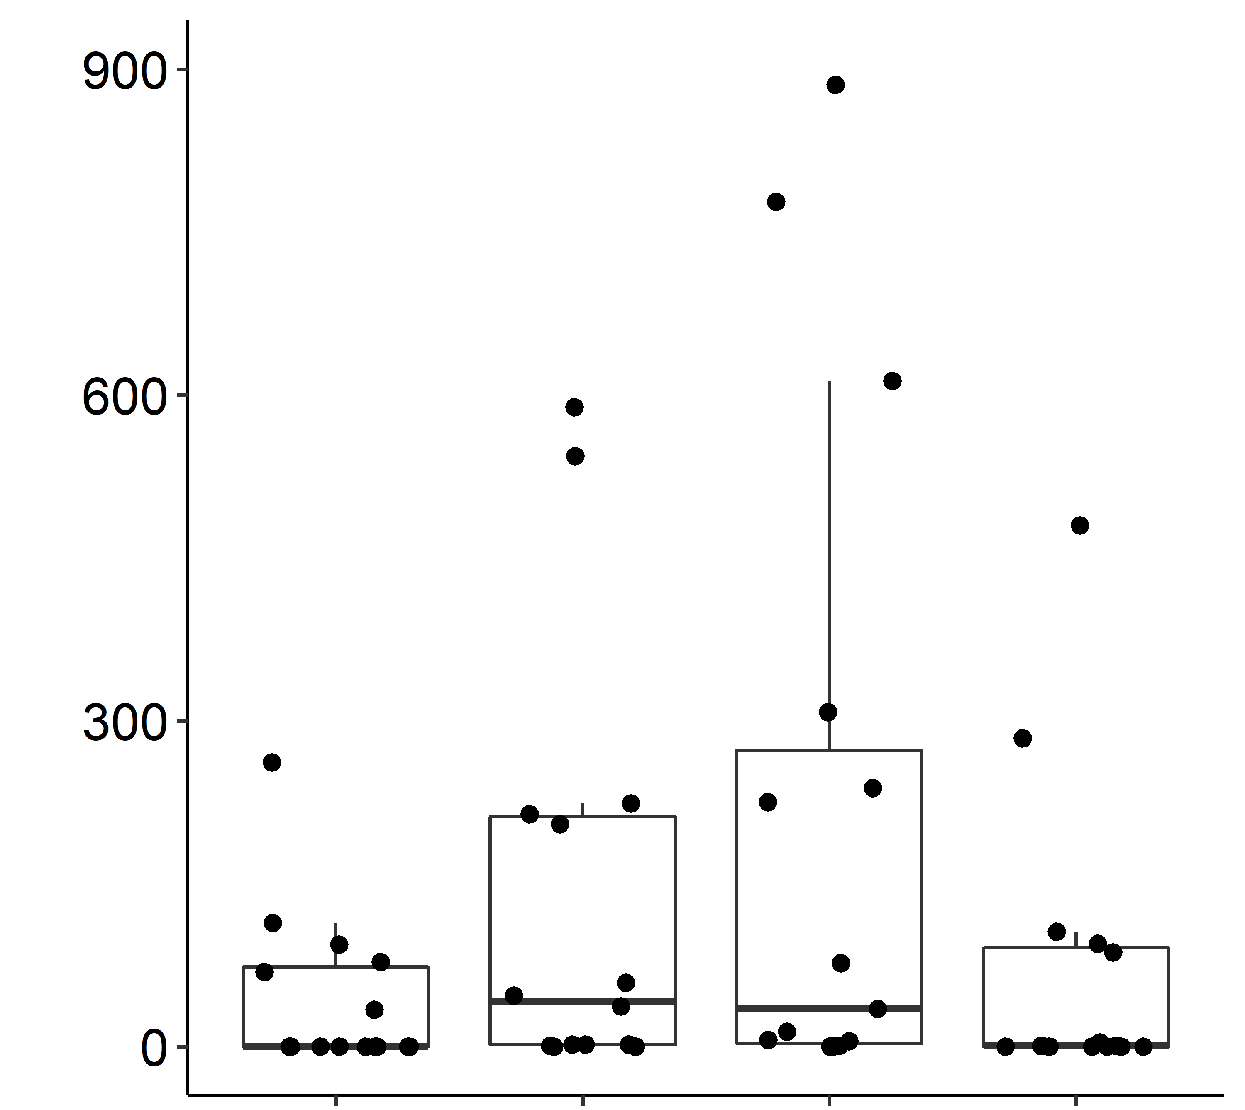
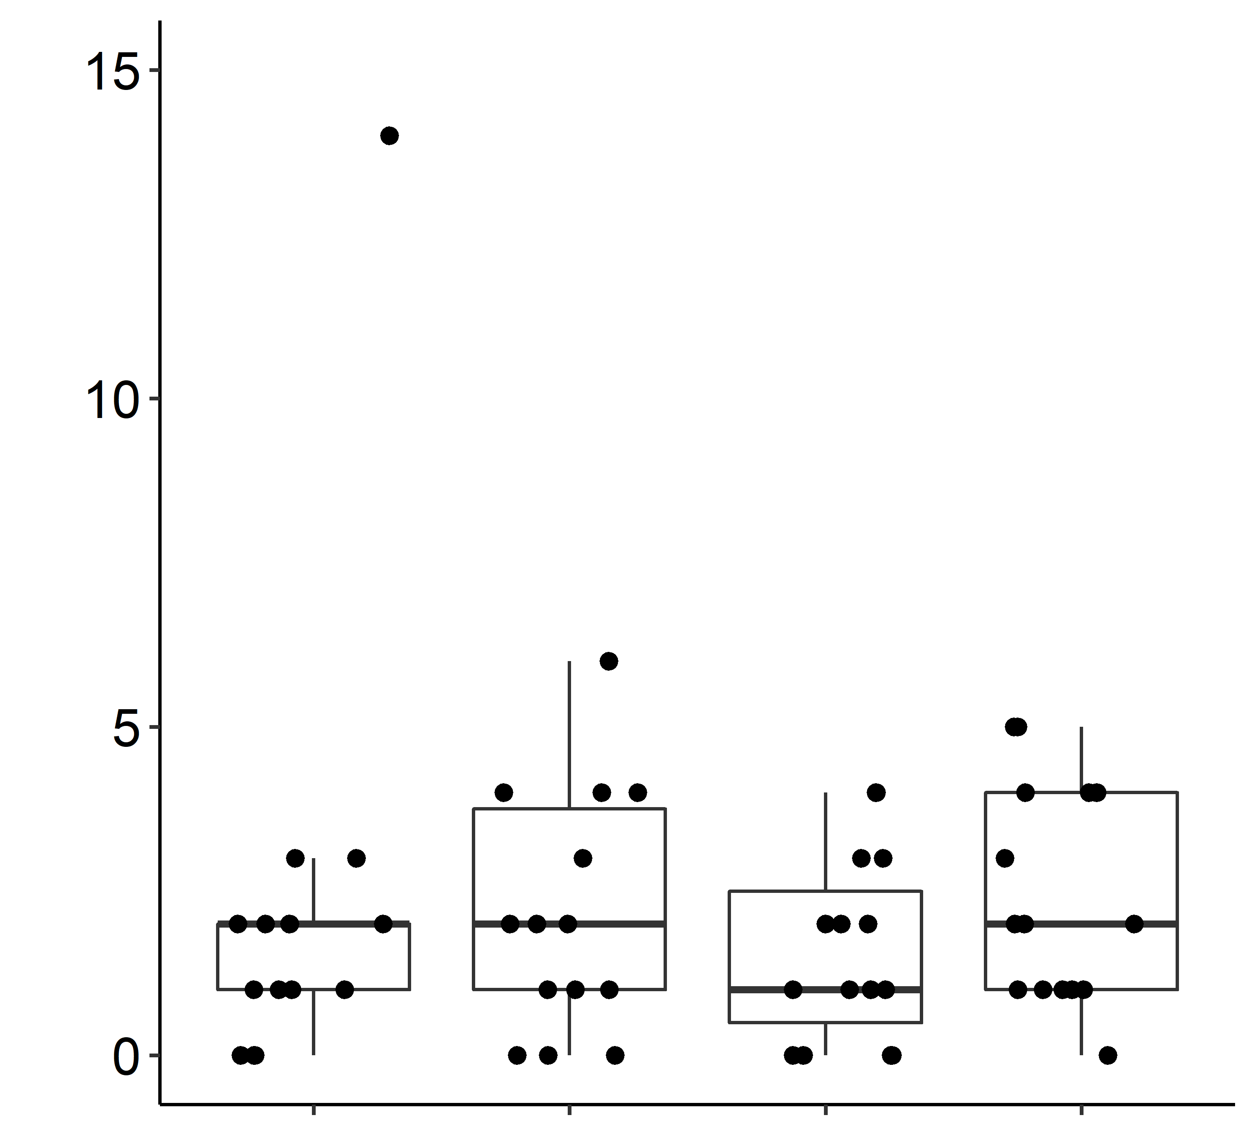
A
B
Total number of meat ants captured
Total number of invertebrate predators captured (meat ants excluded)
Wooded
area
Edge
20 Meters
Grassy
area
Wooded
area
Edge
20 Meters
Grassy
area

Slide 7
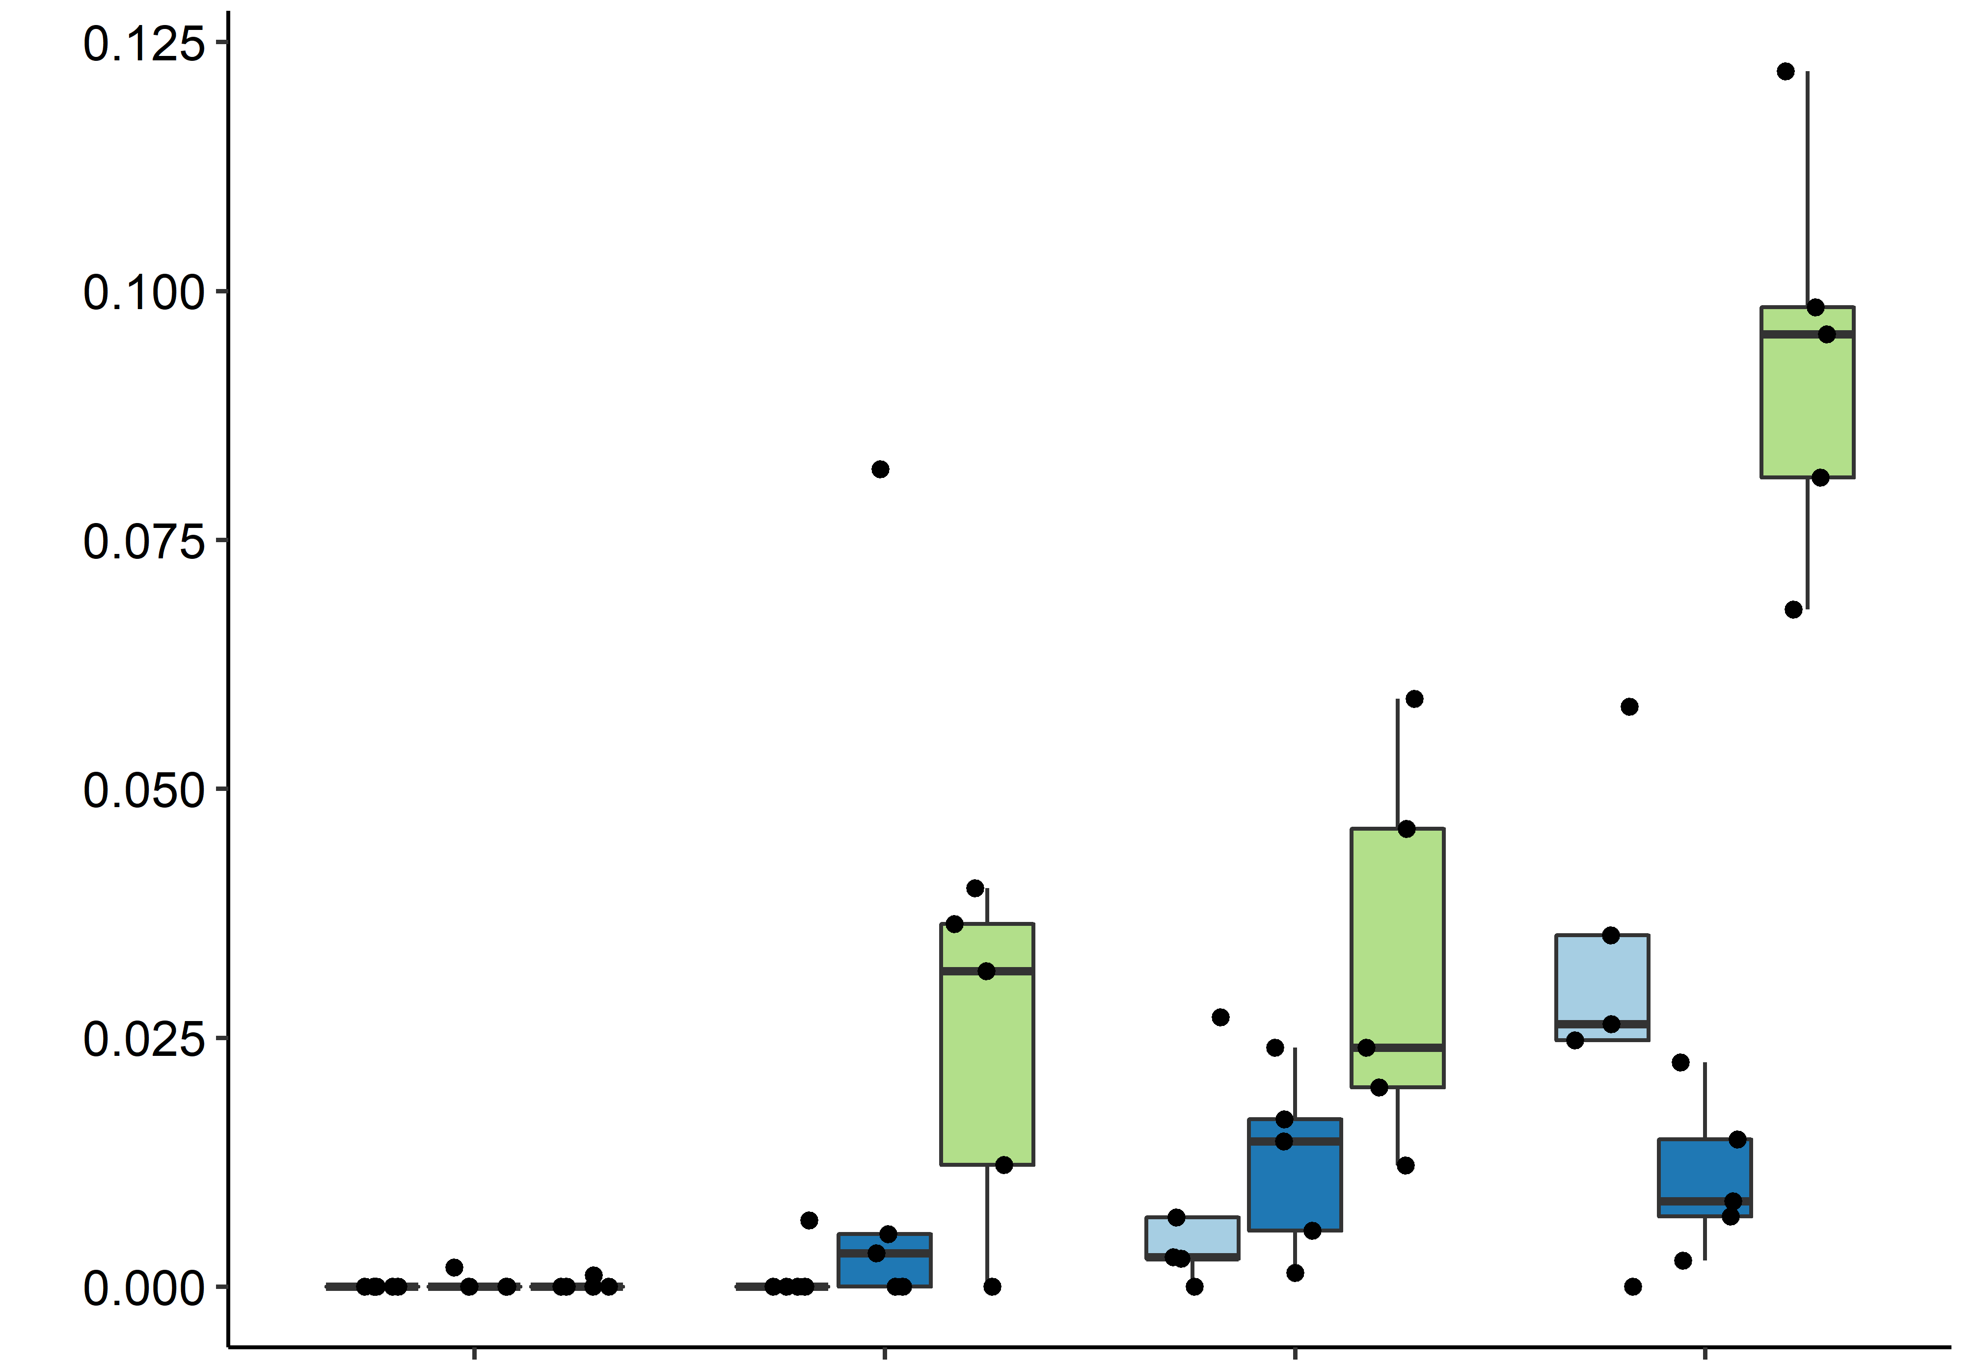
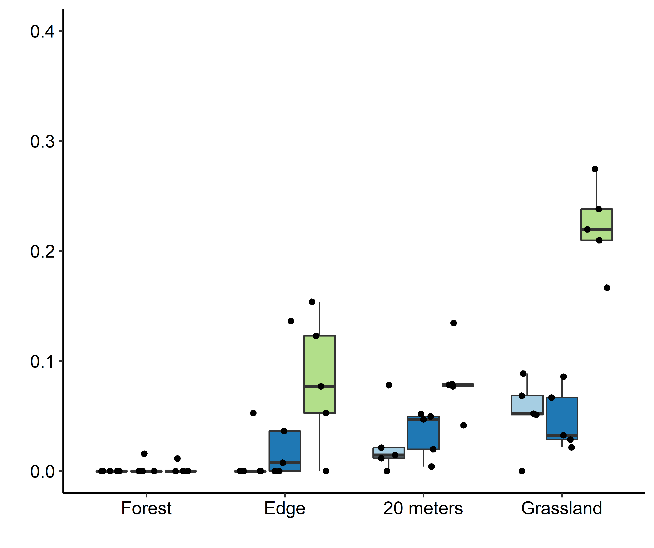
Field 1
Field 2
Field 3
B
A
B
C
A
A
B
A
A
a
a
a
a
a
Locust density (individuals m² ⁻¹)
A
A
B
a
a
a
A
A
A
a
a
a
Wooded area
Edge
20 meters
Grassy
area
Wooded area
Edge
20 meters
Grassy
area

Slide 8
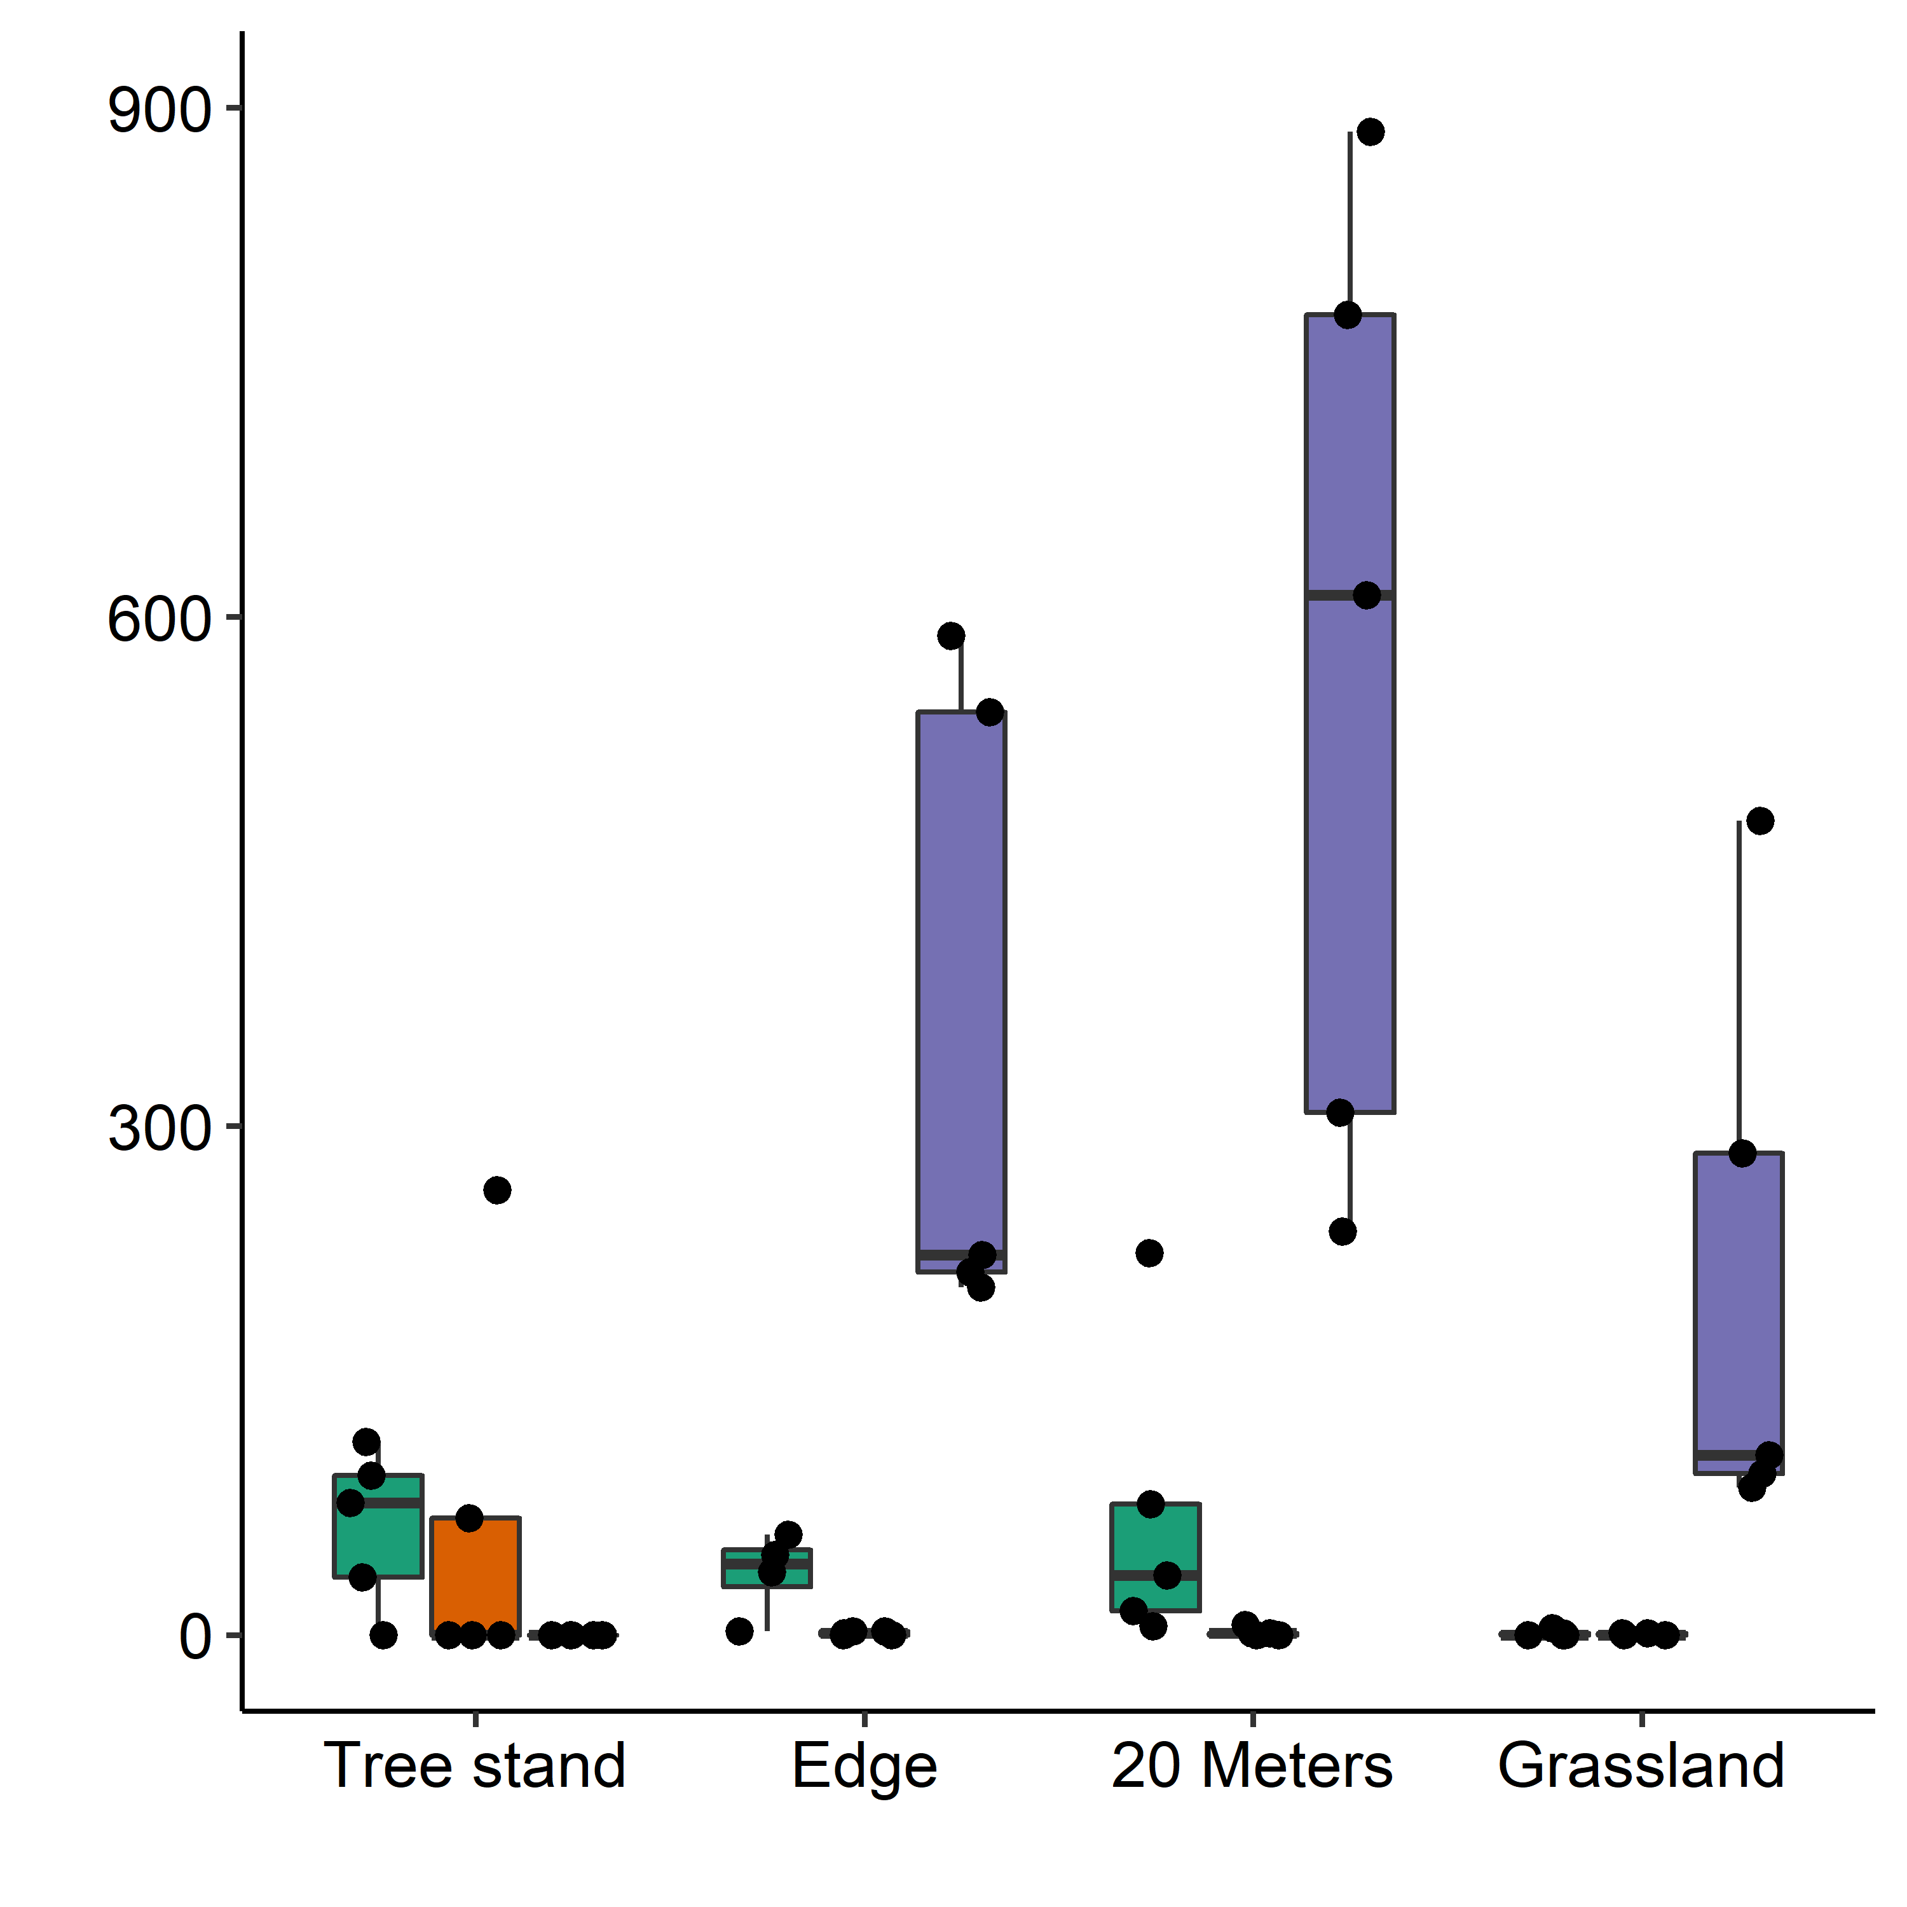
Field 1
Field 2
Field 3
A
A
B
A
A
C
A
A
B
Total number of meat ants captured
A
A
A
Wooded
area
Edge
20 meters
Grassy
area

Slide 9
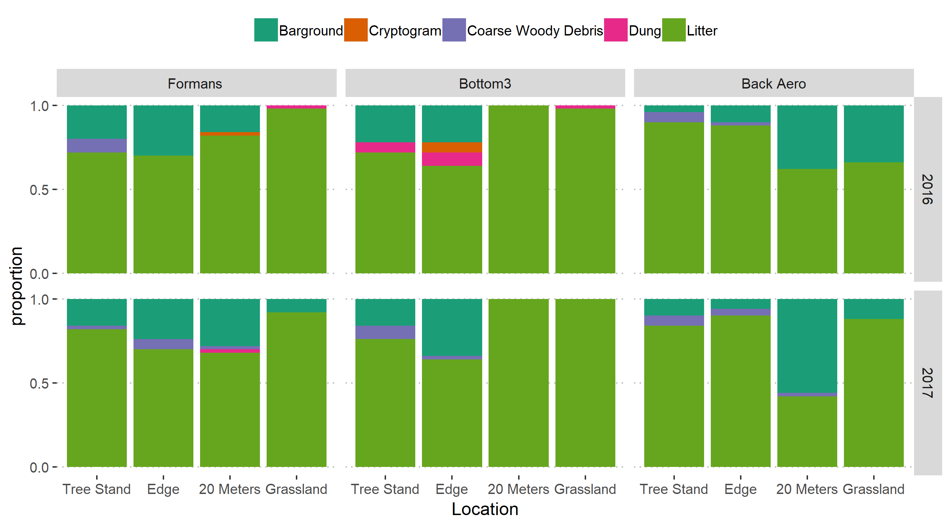
Field
1
2
3
Year
Wooded
area
Edge
20 Meters
Grassy
area
Wooded
area
Edge
20 Meters
Grassy
area
Wooded
area
Edge
20 Meters
Grassy
area

Slide 10
